Slide 1
“GOSPEL PREACHING IN THE FIRST CENTURY”
Paul In The Synagogue At Antioch Of Pisidia
Acts 13:13-52

Slide 2
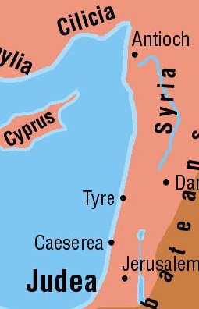
Paul’s Travels
Church in Antioch of Syria sent Paul on three preaching journeys.
  Acts 13-15
  Acts 15-18
  Acts 18-21

Slide 3
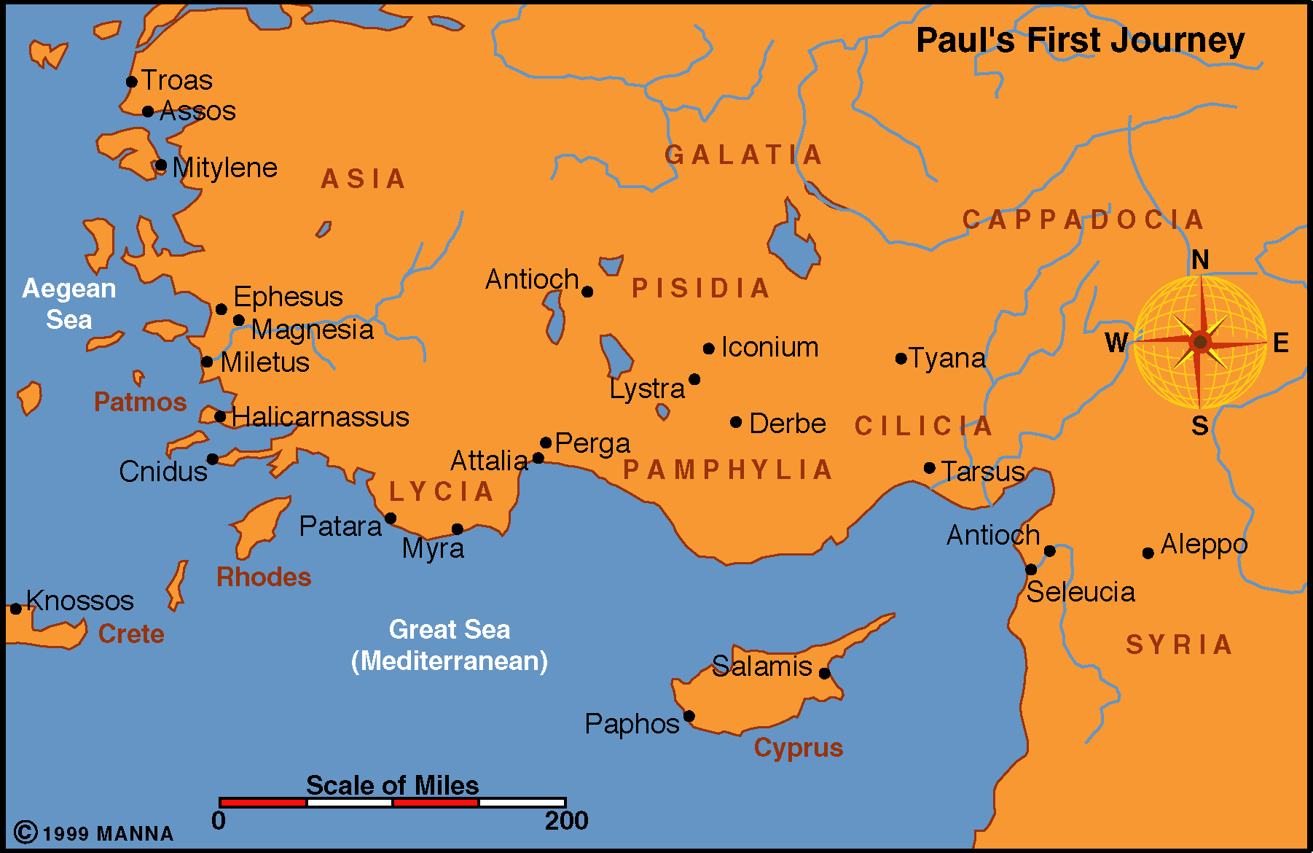
Antioch
Seleucia
CYPRUS
Salamis
Acts 13-14
Approximately 2-3 Years
45-48 AD
Begins in Antioch
Seleucia
  Boarded a ship
  To Cyprus (90 miles)
Salamis
  Preached to the Jews in synagogue

Slide 4
Paphos
  About 100 miles from Salamis
    Other end of Cyprus
  Sergius Paulus desired to hear the word of God
  Elymas tries to turn him away from “the faith” - Acts 13:6-11
  Saul is referred to as Paul for the first time – Acts 13:9
  Now it is “Paul and Barnabas” not “Barnabas and Saul”
Antioch
Seleucia
CYPRUS
Salamis
Paphos

Slide 5
Antioch
Seleucia
CYPRUS
Salamis
Paphos
PAMPHYLIA
Perga
Perga
  12 miles inland
  150 miles from Paphos
  John Mark (writer of Mark) turned back and went to Jerusalem. Acts 13:13

Slide 6
Antioch
Seleucia
CYPRUS
Salamis
Paphos
PAMPHYLIA
Perga
PISIDIA
Antioch
Antioch (Pisidia)
  100 miles from Perga
  Paul preached at least two Sabbaths
    Acts 13:42
  Paul’s 1st recorded sermon – 13:16-41
  Sermons of Peter and Stephen had same line of thought

Slide 7
Antioch of Pisidia. Acts 13:14-15
Note the substance of his sermon. Verses 27-39
  PAUL REVIEWS THE HISTORY OF ISRAEL …
Their deliverance from Egypt and reception of Canaan. Acts 13:16-19
The period of the Judges and the beginning of their Kings. Acts 13:20-21
The promise to David, fulfilled with the coming of Jesus. Acts 13:22-25

Slide 8
Antioch of Pisidia. Acts 13:27-39
Note the substance of his sermon.
PAUL PROCLAIMS THE GOSPEL OF CHRIST …
Addressed to both Jews and God-fearers.
Acts 13:26
The death of Jesus by the rulers in Jerusalem. Acts 13:27-29
The resurrection of Jesus by God, witnessed by many. Acts 13:30-31
These are glad tidings, foretold by prophecy.
Acts 13:32-35; cf. Psalms 2:7; Isaiah 55:3;
Psalms 16:10
For David saw corruption, while He who was raised did not. Acts 13:36-37

Slide 9
Antioch of Pisidia. Acts 13:27-39
Note the substance of his sermon.
PAUL OFFERS SALVATION WITH A WARNING …
Preaching forgiveness of sins through Jesus, not the Law. Acts 13:38-39
Warning them of unbelief, in the words of Habakkuk. Acts 13:40-41; Habakkuk 1:5
THE RESPONSE …
Begged by the Gentiles to preach the same to them the next Sabbath. Acts 13:42
Many Jews and devout proselytes encouraged to continue in the grace of God. Acts 13:43

Slide 10
Antioch of Pisidia. Acts 13:44-48
Note the substance of his sermon.
THE FOLLOWING SABBATH …
Almost the whole city gathered to hear.
Acts 13:44
Envious Jews contradicted and blasphemed the things spoken by Paul. Acts 13:45
Having judged themselves unworthy of eternal life, Paul turned to the Gentiles. Acts 13:46-47
Gentiles were glad and glorified the Word.
Acts 13:48
“And as many as had been appointed (ordained, KJV) to eternal life believed”

Slide 11
Antioch of Pisidia. Acts 13:44-48
  CONCLUSION:
In preaching the gospel in the synagogue at Antioch …
Paul proclaimed the death, burial, and resurrection of Jesus Christ. Acts 13:26-30
Eyewitness testimony and Old Testament prophecy were used to make his case. Acts 13:31-37
He taught faith in Jesus as the way to forgiveness of sins, not the Law. Acts 13:38-39
One makes themselves unworthy of eternal life by rejecting the Word. Acts 13:46
If you are desire eternal life, you will believe in Christ! Acts 13:48

Slide 12
Antioch of Pisidia. Acts 13:44-48
  CONCLUSION:
In making personal application, you might well ask yourself …
Do you accept as truth the death, burial, and resurrection of Jesus Christ?
If not, have you seriously examined the eyewitness testimony and Old Testament prophecy?
Do you believe that Jesus is the only way to forgiveness of sins?
Or have you made yourself unworthy of eternal life by rejecting the gospel?

